Slide 1
EEE 431 COMMUNICATION SYSTEMS AND CHANNELS

Slide 2
EEE 431: COMMUNICATION SYSTEMS AND CHANNELS (Core, 2 UNITS)
Information Theory: Information measure: entropy and information rate;
Transmission on discrete channels (binary symmetric channel model); Discrete channel capacity; SNR; Bandwidth/SNR trade-off
Baseband Digital Transmission: Digital Signaling formats (NRZ, RZ)
Line encoding: BNZS, HDB-3; Errors in digital transmission and error models; Linear reception techniques; maximum likelihood receiver; Integral reception methods etc; Phase correction techniques in linear reception; Asynchronous and synchronous transmission.
Error Correction: Coding theory and abstract algebra; Source coding (Fano-Shannon, Huffmann algorithms); Channel coding; Classification of codes; Linear block codes, Hamming cyclic, BCH, RS convolutions codes; ARQ systems; FEC system.
Bandpass Digital Transmission: Tradition digital modulation techniques; FSK, PSK & QAM; State of the art techniques; MSK, CPM etc; Performance of modulation in fading channels; Criteria governing modulation section; Modems and equalization.
Protocols: The OSI reference model: Lower level protocols; RTSP, RTP, TCP/IP, RSVP; Application level protocols; HTTP, FTP etc.
Synchronization and Timing Control; Clock recovery; carrier recovery; scrambler-descrambler, and encryption.

Slide 3
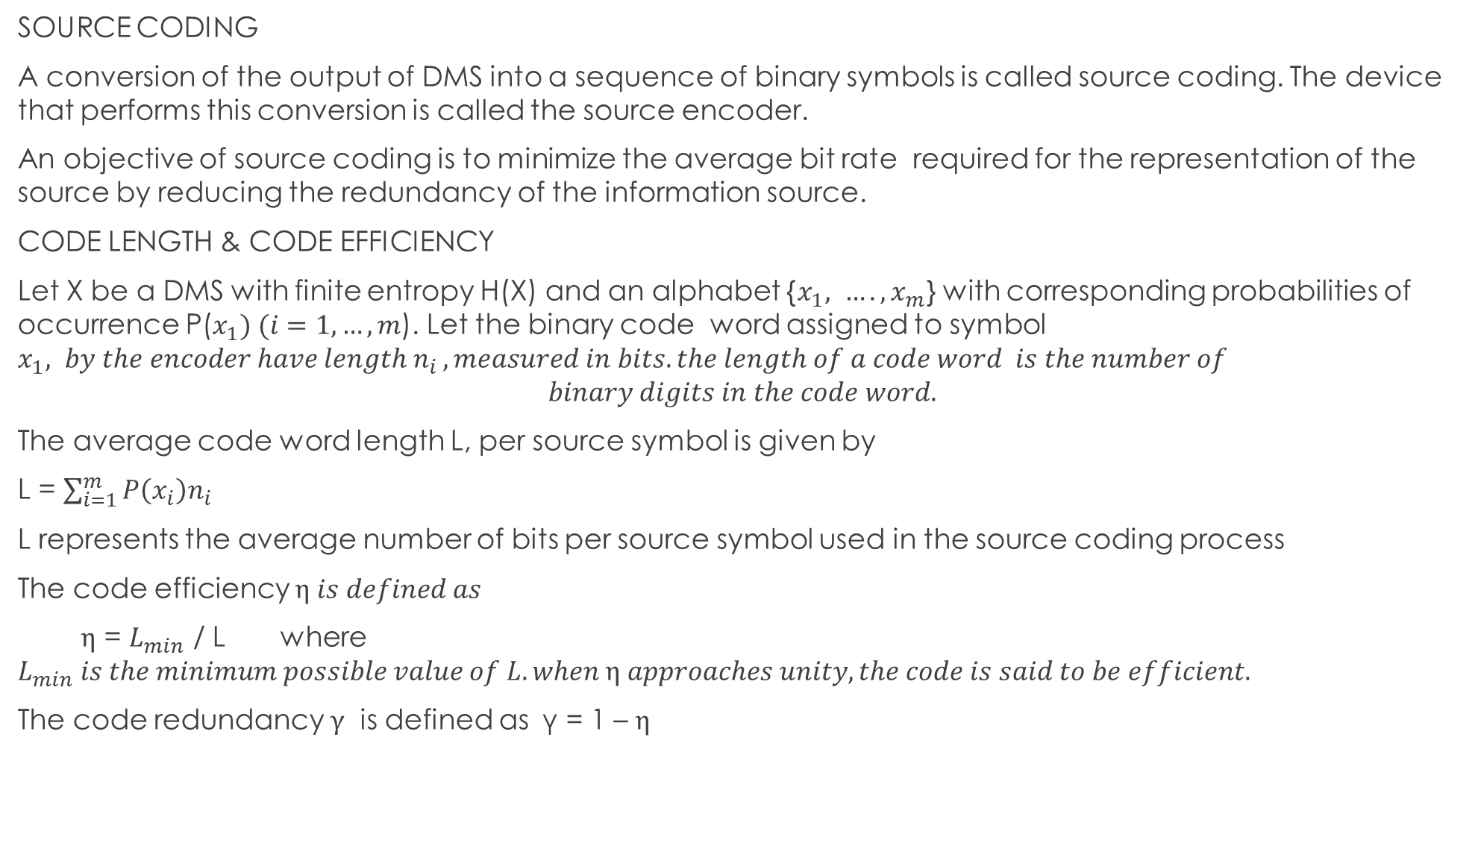
SOURCE CODING
A conversion of the output of DMS into a sequence of binary symbols is called source coding. The device that performs this conversion is called the source encoder.
An objective of source coding is to minimize the average bit rate required for the representation of the source by reducing the redundancy of the information source.
CODE LENGTH & CODE EFFICIENCY
Let X be a DMS with finite entropy H(X) and an alphabet {$x_{1}{, …. , x}_{m}$} with corresponding probabilities of occurrence P($x_{1}) (i=1, …, m$). Let the binary code word assigned to symbol $x_{1}{, by the encoder have length n}_{i}, measured in bits. the length of a code word is the number of$
$$binary digits in the code word.$$
The average code word length L, per source symbol is given by
L = $\sum_{i=1}^{m}{P\left(x_{i}\right)n_{i}}$
L represents the average number of bits per source symbol used in the source coding process
The code efficiency $η is defined as$
$η$ = $L_{min}$ / L where $L_{min} is the minimum possible value of L. when η approaches unity, the code is said to be efficient.$
The code redundancy $γ$ is defined as γ = 1 – $η$

Slide 4

SOURCE CODING THEOREM
The SCT states that for a DMS X with entropy H(X), the average code word length L per symbol is bounded as
L $≥H\left(X\right) L can be made as close to H\left(X\right)as desired for suitably chosen code.$
Thus with $L_{min}=H\left(X\right), the code efficiency can be rewritten as$ η = H(X)/L

Slide 5
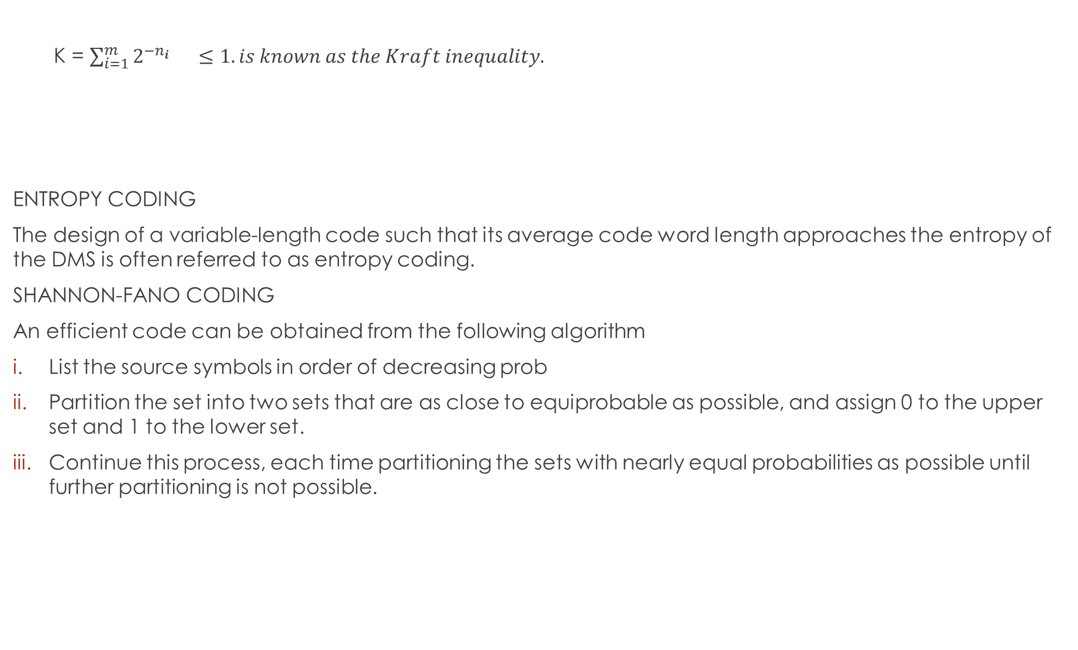
K = $\sum_{i=1}^{m}{2^{−n_{i}}}$ $≤1. is known as the Kraft inequality.$
ENTROPY CODING
The design of a variable-length code such that its average code word length approaches the entropy of the DMS is often referred to as entropy coding.
SHANNON-FANO CODING
An efficient code can be obtained from the following algorithm
List the source symbols in order of decreasing prob
Partition the set into two sets that are as close to equiprobable as possible, and assign 0 to the upper set and 1 to the lower set.
Continue this process, each time partitioning the sets with nearly equal probabilities as possible until further partitioning is not possible.

Slide 6
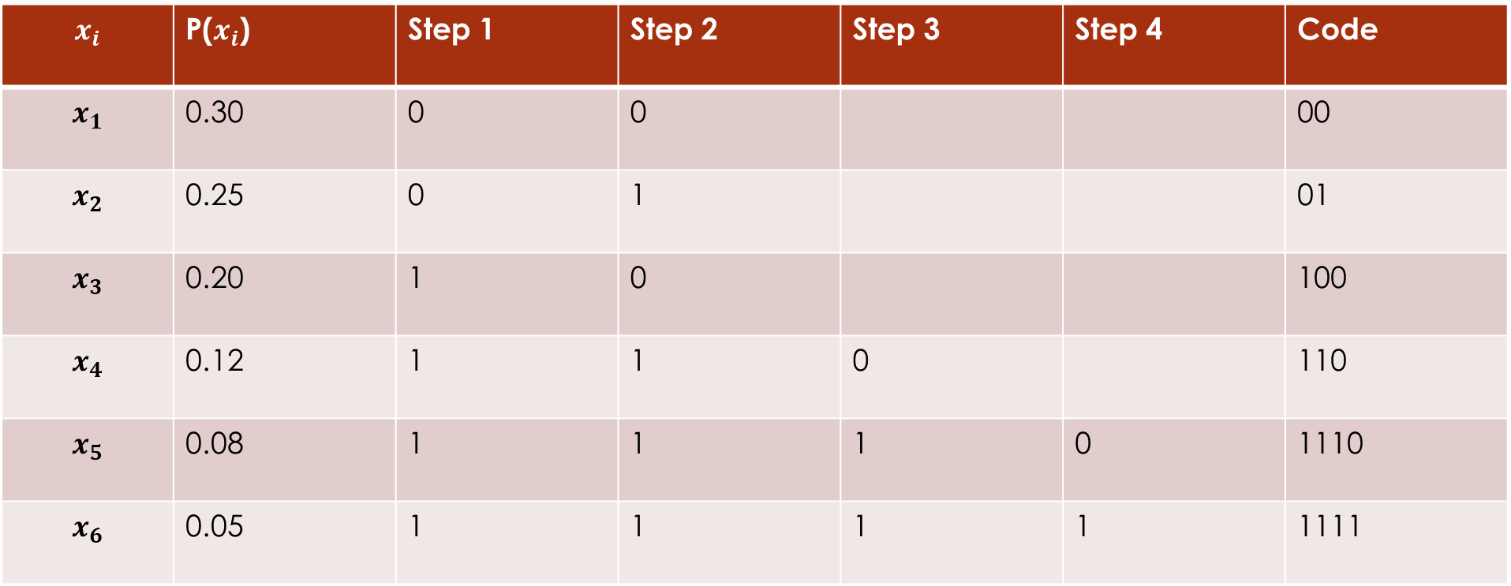
$$x_{i}$$ | P($x_{i}$) | Step 1 | Step 2 | Step 3 | Step 4 | Code
$$x_{1}$$ | 0.30 | 0 | 0 |  |  | 00
$$x_{2}$$ | 0.25 | 0 | 1 |  |  | 01
$$x_{3}$$ | 0.20 | 1 | 0 |  |  | 100
$$x_{4}$$ | 0.12 | 1 | 1 | 0 |  | 110
$$x_{5}$$ | 0.08 | 1 | 1 | 1 | 0 | 1110
$$x_{6}$$ | 0.05 | 1 | 1 | 1 | 1 | 1111

Slide 7
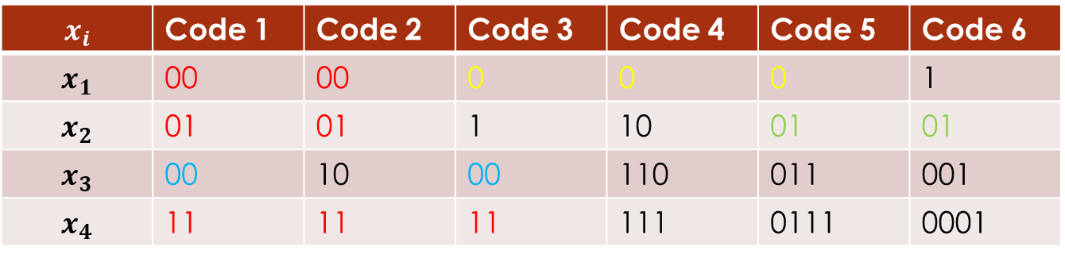
H(X) = 2.36 b/symbol
L = 2.38 b/symbol
η = H(X)/L = 0.99
CLASSIFICATION OF CODES
Binary code : a source of size 4 encoded in binary
i. fixed-length codes
code 1 & 2; L = 2
Variable-length codes
not fixed; all codes except codes 1 & 2
iii. Distinct codes
if each code word is distinguishable from other code words. All codes except code 1 are distinct.
iv. Prefix-free codes
a code in which no code word can be formed by adding code symbols to another code word is called a prefix-free code. Codes 2, 4 & 6
$$x_{i}$$ | Code 1 | Code 2 | Code 3 | Code 4 | Code 5 | Code 6
$$x_{1}$$ | 00 | 00 | 0 | 0 | 0 | 1
$$x_{2}$$ | 01 | 01 | 1 | 10 | 01 | 01
$$x_{3}$$ | 00 | 10 | 00 | 110 | 011 | 001
$$x_{4}$$ | 11 | 11 | 11 | 111 | 0111 | 0001

Slide 8
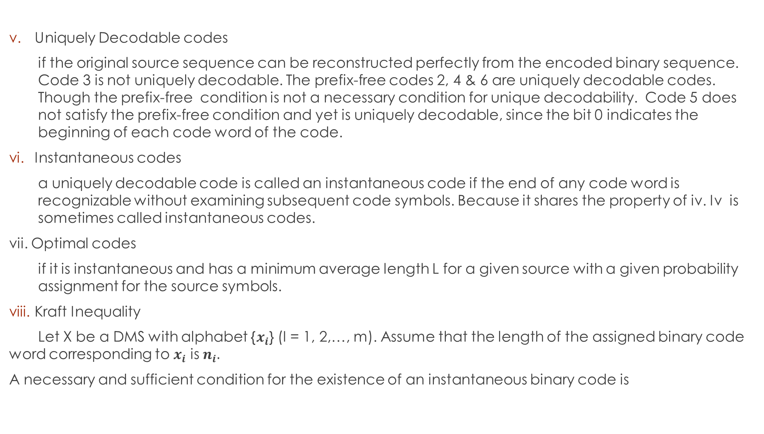
Uniquely Decodable codes
if the original source sequence can be reconstructed perfectly from the encoded binary sequence. Code 3 is not uniquely decodable. The prefix-free codes 2, 4 & 6 are uniquely decodable codes. Though the prefix-free condition is not a necessary condition for unique decodability. Code 5 does not satisfy the prefix-free condition and yet is uniquely decodable, since the bit 0 indicates the beginning of each code word of the code.
Instantaneous codes
a uniquely decodable code is called an instantaneous code if the end of any code word is recognizable without examining subsequent code symbols. Because it shares the property of iv. Iv is sometimes called instantaneous codes.
vii. Optimal codes
if it is instantaneous and has a minimum average length L for a given source with a given probability assignment for the source symbols.
Kraft Inequality
Let X be a DMS with alphabet {$x_{i}$} (I = 1, 2,…, m). Assume that the length of the assigned binary code word corresponding to $x_{i}$ is $n_{i}.$
A necessary and sufficient condition for the existence of an instantaneous binary code is

Slide 9
HUFFMAN ENCODING
This results in an optimum code. It is the code that has the highest efficiency.
List the source symbols in order of decreasing prob.
Combine the probabilities of the two symbols having the lowest probabilities, and reorder the resultant probabilities; this step is called reduction 1. The same procedure is repeated until there are two ordered probabilities remaining.
Start encoding with the last reduction, which consists of exactly two ordered probabilities. Assign 0 as the first digit in the code words for all the source symbols associated with the first probability; assign 1 to the second prob.
Now go back and assign 0 and 1 to the second digit for the two probabilities that were combined in the previous reduction step, retaining all asignments made in step 3.
Keep regressing this way until the first column is reached.

Slide 10
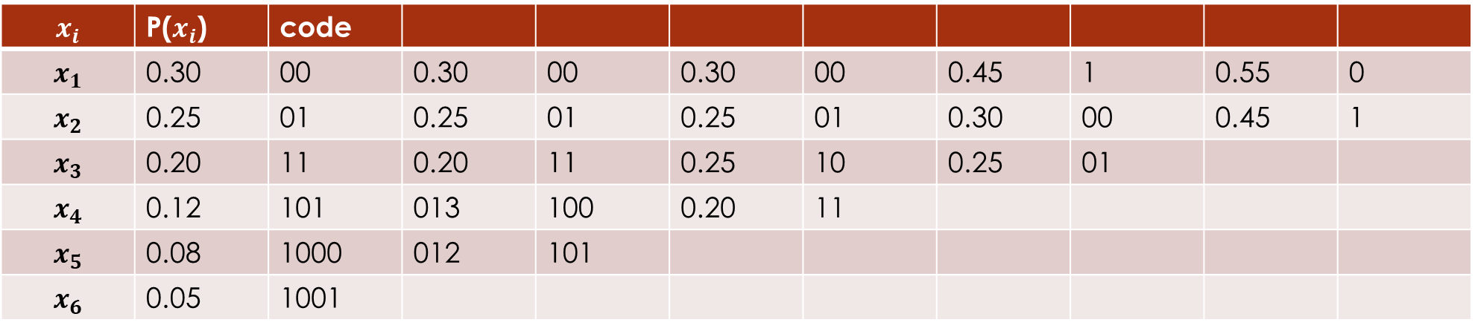
$$x_{i}$$ | P($x_{i}$) | code
$$x_{1}$$ | 0.30 | 00 | 0.30 | 00 | 0.30 | 00 | 0.45 | 1 | 0.55 | 0
$$x_{2}$$ | 0.25 | 01 | 0.25 | 01 | 0.25 | 01 | 0.30 | 00 | 0.45 | 1
$$x_{3}$$ | 0.20 | 11 | 0.20 | 11 | 0.25 | 10 | 0.25 | 01
$$x_{4}$$ | 0.12 | 101 | 013 | 100 | 0.20 | 11
$$x_{5}$$ | 0.08 | 1000 | 012 | 101
$$x_{6}$$ | 0.05 | 1001

Slide 11
ERROR DETECTION AND CORRECTION
Data can be corrupted during transmission. For reliable communication, errors must be detected and corrected
Reliable network systems must have a mechanism for detecting and correcting such errors.
TYPES OF ERRORS
Unpredictable changes due to interference which can alter or change the shape of the signal.
Single-Bit Error
Only one bit in the data unit has changed.
These are the least likely type of error in serial data transmission.
Imagine sending data at 1 Mbps. => each bit lasts for 1/1000 000 s or 1 µs thus for it to occur noise must last for a duration of only 1µs which very rare. It lasts longer than that.
It can however occur if we are sending data using parallel transmission, 8 wires used to send all 8 bits of a 1 byte at the same time and one of the wires is noisy.
BurstError
Means that 2 or more bits in the data unit have changed
This is most likely to occur in serial transmission. The duration of the noise is usually longer than the duration of a single bit.=> when noise effects data, it affects a set of bits. The number of bits affected depends on the data rate and the duration of the noise.=> Ikbps a noise of 1/100 s can affect 10 bits 1Mbps = 10,000 bits

Slide 12
DETECTION
Although the goal of error checking is to correct errors, most of the time, we first need to detect errors. Error detection is simpler than error correction and is the first step in error correction process.
REDUNDANCY
Error detection uses the concept of redundancy, which means adding extra bits for detecting errors at the destination. How about other methods to check the accuracy of a data unit?
Using redundancy bit to check the accuracy of a data unit.
Receiver node Sender node
10100000000101010
10100000000101010
Data Data
10100000000101010
Yes
NO
Reject Data
Ok
10100000000101010 10111101
10100000000101010 10111101
Data & Redundancy
Data & Redundancy check

Slide 13
Three types of Redundancy checks are common in data communications: parity check, cyclic redundancy check (CRC) and checksum
Detection Methods mechanism
Parity Check is the most common and least expensive for error detection. It can be simple or two-dimensional.
Here, a parity bit is added to every data unit so that the total number of 1’s is even (or odd for odd-parity).
Parity generator and even-parity checker.
Simple parity check can detect all single-bit errors. It can detect burst errors only if the total number of errors in each data unit is odd.
Two-dimensional parity check
A better approach. A block of bits is divided into rows and a redundant row of bits is added to the whole block. This increases the likelihood of detecting burst errors. If 2 bits in one data unit are damaged and two bits in exactly the same positions in another data unit are also damaged, the checker will not detect an error.
Detection Methods
Cyclic Redundancy Check
Checksum
Parity Check

Slide 14
Cyclic Redundancy Check (CRC)
The third and most powerful of the redundancy checking techniques. Unlike parity which is based on addition , it is based on binary division. A sequence of redundant bits, called the CRC or the CRC remainder, is appended to the end of a data unit so that the resulting data unit becomes exactly divisible by a second, predetermined binary number. At its destination, the incoming data unit is divided the same number. If at this stage there is no remainder, the data unit is assumed to be intact and is therefore accepted else a reminder means that there is an error in transit and must be rejected.
To be valid, a CRC must have two qualities. It must be exactly one less bit than the divisor and appending it to the end of the data string must make the resulting bit sequence exactly divisible by the divisor.
Receiver Sender
Data CRC
Data 00…0
n bits
N + 1 bits
Remainder
n bits
Divisor
Data CRC
Divisor
Remainder
CRC
Zero, accept
Nonzero, reject

Slide 15
ERROR CONTROL CODING
For efficient and effective design of codes in order to reliably transmit digital information over a noisy channel thye errors must be controlled.
Codes can either correct or detect errors, depending on the amount of redundancy contained in the code.
Codes that can detect errors are called error-detecting codes and codes that can correct errors are known as error-correcting codes.. There are many different error control codes. These are classified into block codes and convolutional codes.
CHANNEL CODING
A basic block diagram for the channel coding is shown below. The encoder introduces systematic redundancy into the data stream to facilitate error detection and correction. The combined objective of the encoder and decoder is to minimize the effect of channel noise
Channel
Decoder
Binary Message Sequence
Coded
Sequence
Discrete
Memoryless
Channel
Decoded
Binary
Message
Channel Encoder
Noise

Slide 16
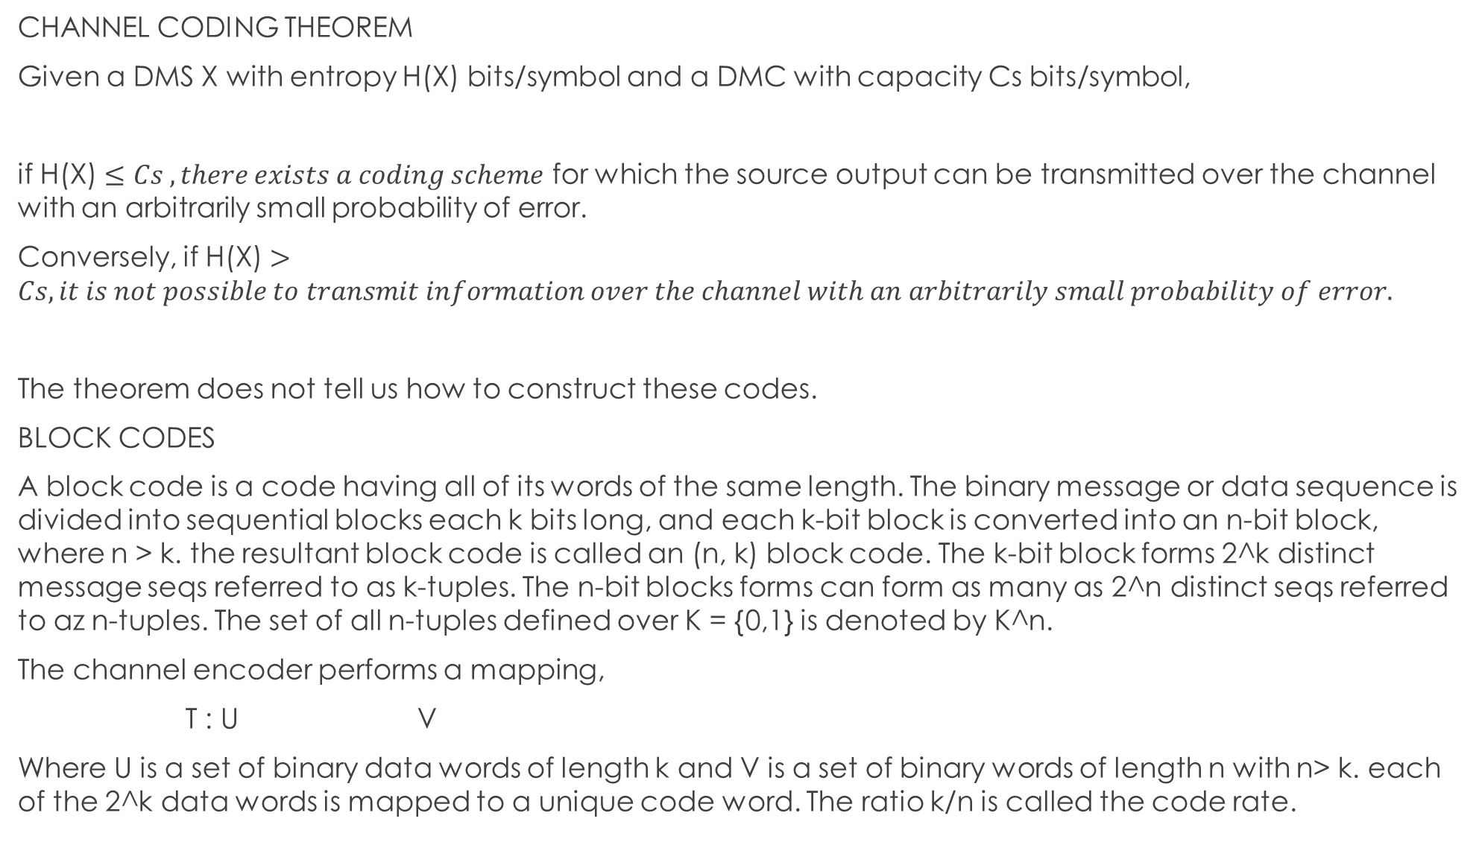
CHANNEL CODING THEOREM
Given a DMS X with entropy H(X) bits/symbol and a DMC with capacity Cs bits/symbol,
if H(X) $≤Cs , there exists a coding scheme$ for which the source output can be transmitted over the channel with an arbitrarily small probability of error.
Conversely, if H(X) $>Cs, it is not possible to transmit information over the channel with an arbitrarily small probability of error.$
The theorem does not tell us how to construct these codes.
BLOCK CODES
A block code is a code having all of its words of the same length. The binary message or data sequence is divided into sequential blocks each k bits long, and each k-bit block is converted into an n-bit block, where n > k. the resultant block code is called an (n, k) block code. The k-bit block forms 2^k distinct message seqs referred to as k-tuples. The n-bit blocks forms can form as many as 2^n distinct seqs referred to az n-tuples. The set of all n-tuples defined over K = {0,1} is denoted by K^n.
The channel encoder performs a mapping,
T : U V
Where U is a set of binary data words of length k and V is a set of binary words of length n with n> k. each of the 2^k data words is mapped to a unique code word. The ratio k/n is called the code rate.

Slide 17
LINEAR BLOCK CODES
Binary Field
A set K ={0,1} is a binary field. The binary field has 2 operations, addition and multiplication such that the results of all operations are in K. the rules of + and x are as follow:
Addition: 0 + 0 = 0 1 + 1 = 0 0 + 1 = 1 1 + 0 = 1
Multiplication: 0 . 0 = 0 1 . 1 = 1 0 . 1 = 1 1 . 0 = 0

Slide 18
ar

